Slide 1


Transformative Impact of Social Media Engagement
Marisol Trejo, akeem Anderson,
Anthony banks ii, drew middleton

Slide 2
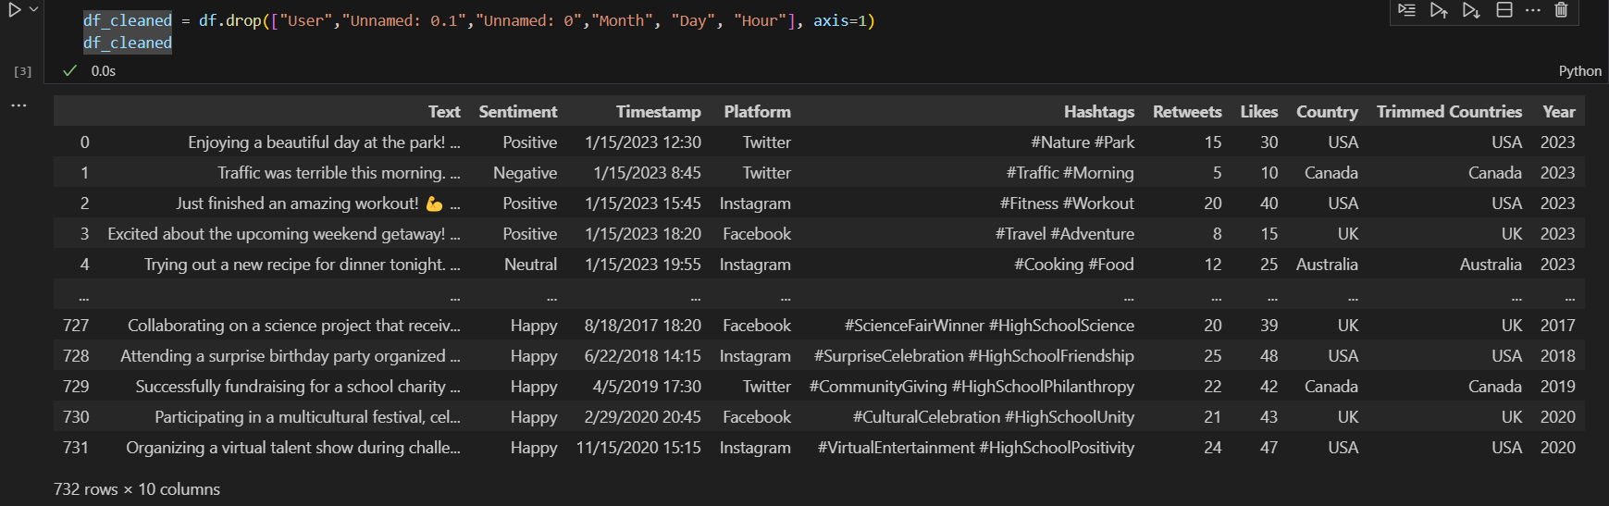
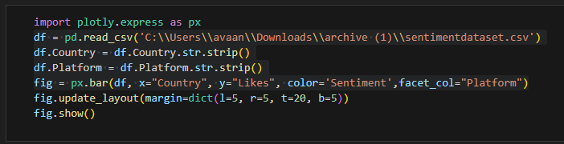
Cleaning Data
Remove Blank Columns
Remove Unwanted Columns
Strip Columns for Accurate Counts

Slide 3
Top 3 Social Media Users Year 2021
In 2021, Canada was the top user in social media.
The activity on social media is helpful for businesses and marketing.

Slide 4
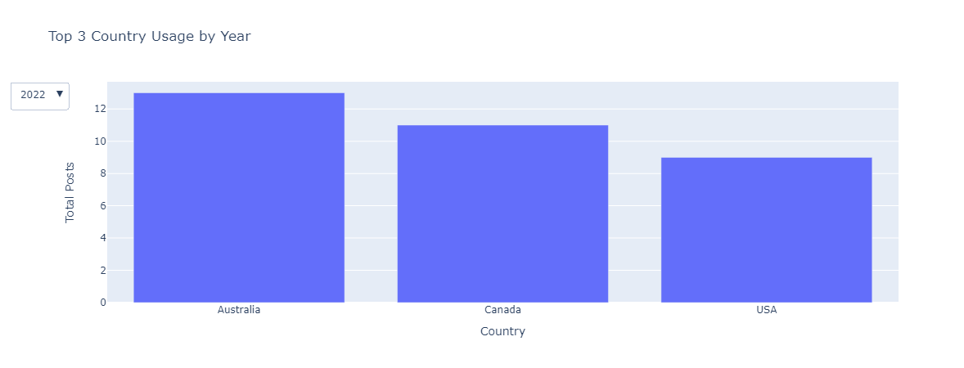
Top 3 Social Media Users Year 2022
The top social media in 2022 was Australia.
How could this help a country?
Tourism or economically.

Slide 5
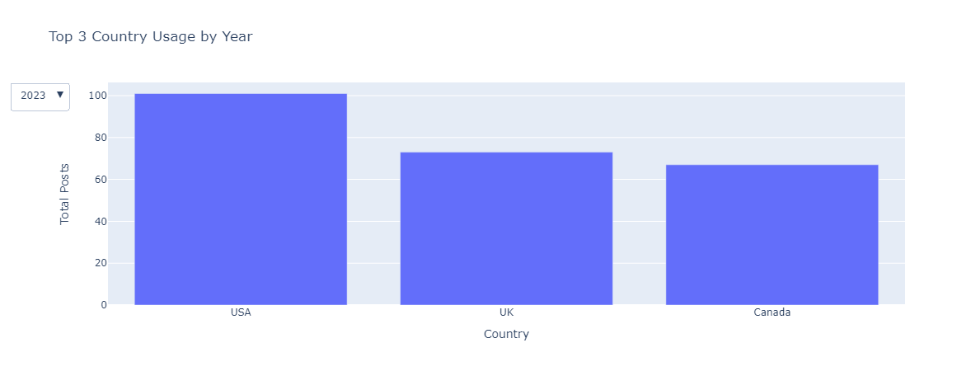
Top 3 Social Media Users Year 2023
Top Social media user was the US in 2023.
Followed by the UK and Canada.
Was the interactions positive, negative or neutral?

Slide 6
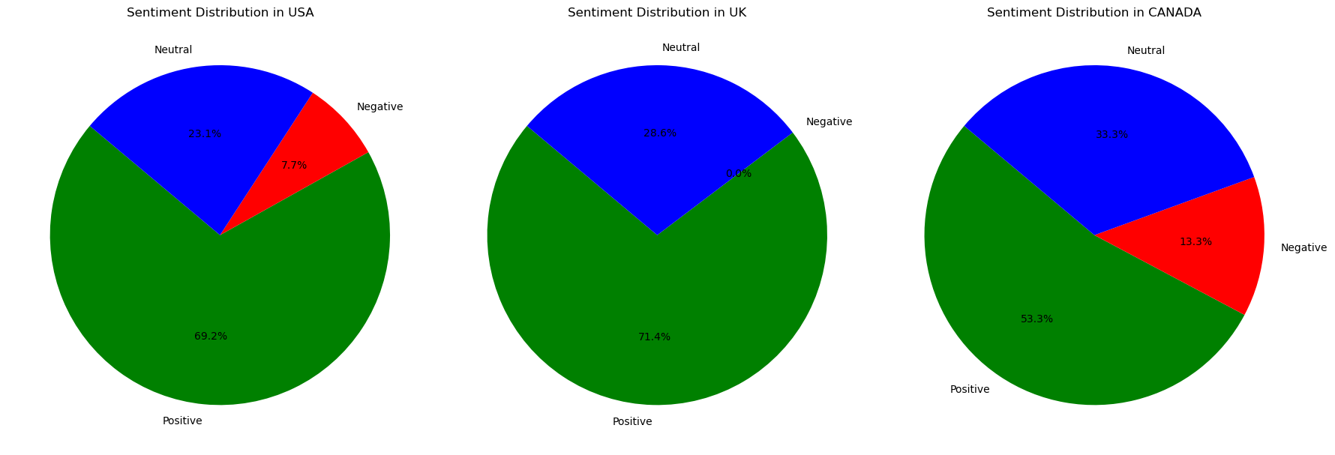
Sentimental Percentages of Top 3 Year 2023

Slide 7
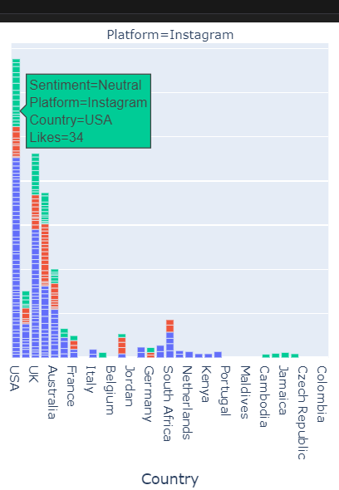
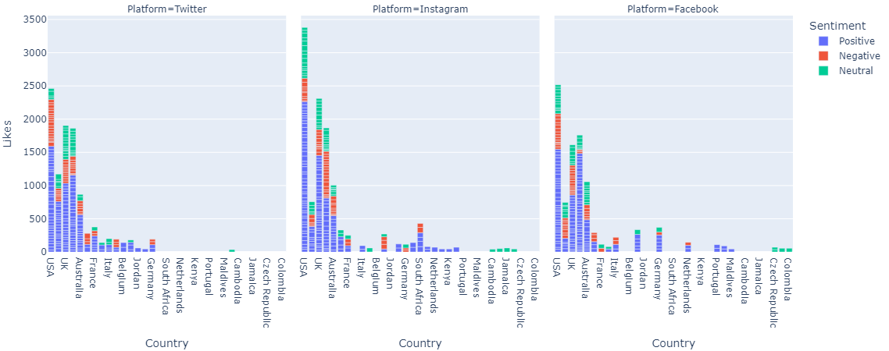
Positive Negative and Neutral Likes Per Country

Slide 8
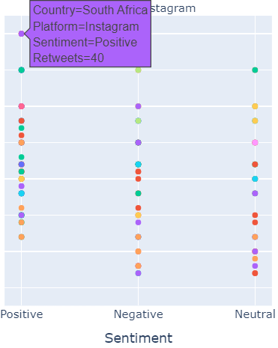
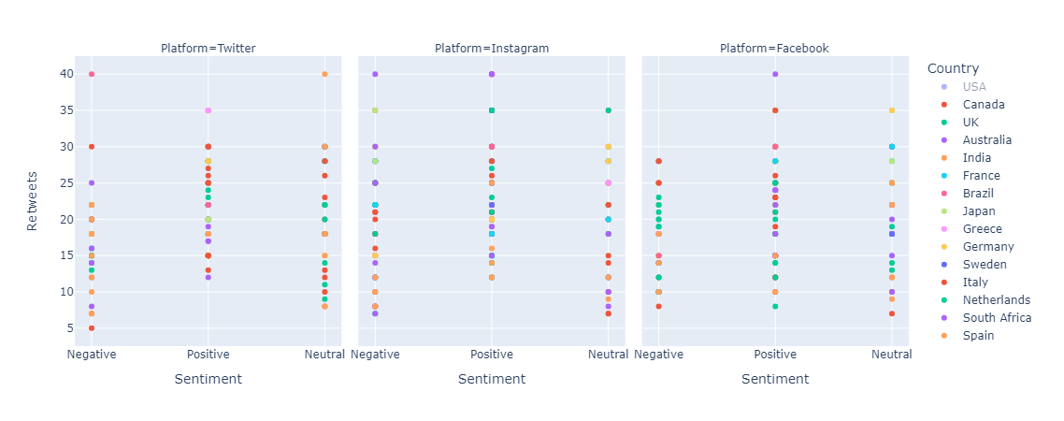
Total Retweets on Each Platform Positive Negative and Neutral

Slide 9
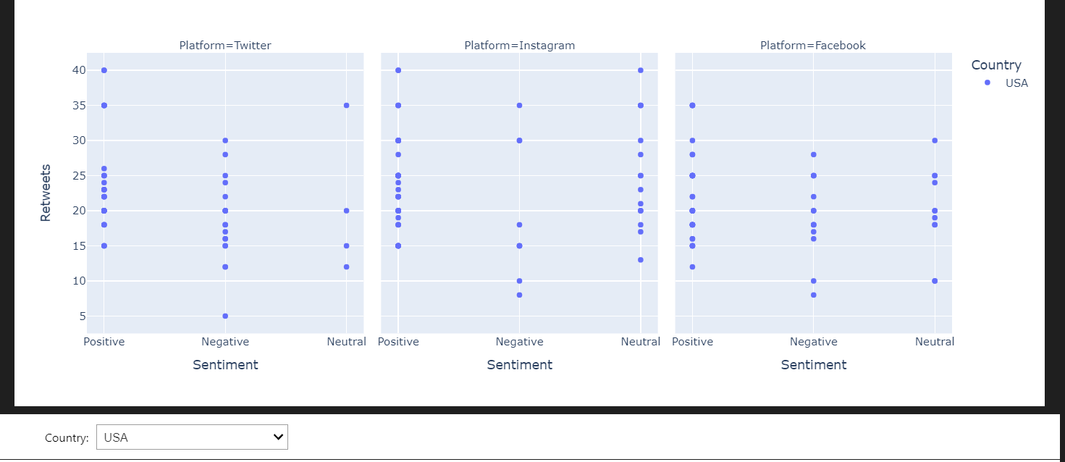
Positive, Negative, Neutral Retweets of USA

Slide 10
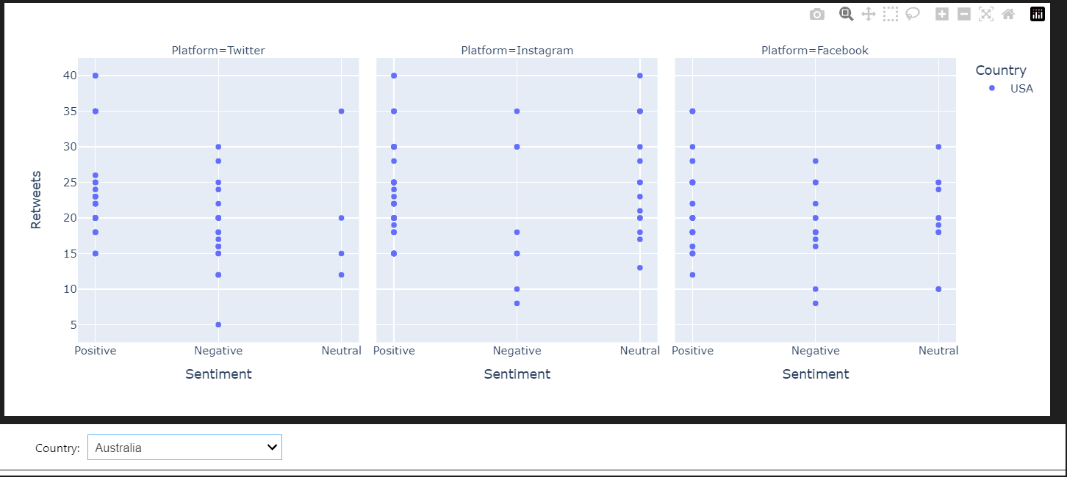
Interactive Graph: Australia

Slide 11
Data and References
Data
https://www.kaggle.com/code/alkidiarete/social-media-analysis-sentiment/notebook
References
Tutor Sessions
https://plotly.com/python/facet-plots/
https://ipywidgets.readthedocs.io/en/latest/examples/Widget%20Basics.html

Slide 12

Thank You!
Any further Questions or Observations are appreciated!

